Slide 1


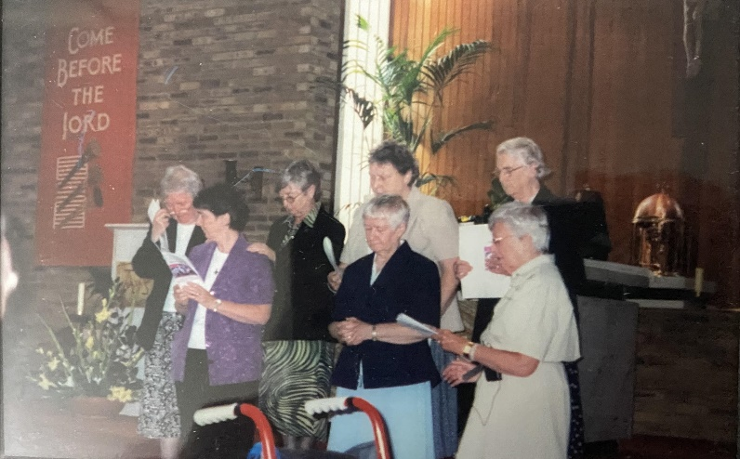
Mary Ward Loreto: Working Together to Secure Freedom from Human Trafficking in Albania and UK
OUR HISTORY
2003: IBVM Big Mission Discernment: Serving The Greatest Good.
MW IBVM Women called to make a corporate discernment
Open a new mission outside the boundaries of each Province in the world.
By 2005 8 New Missions established
South Sudan, Zambia, Ecuador, East Timor, Seychelles, Ghana, Bangladesh, Albania
How did England’s discernment lead to Albania?
Why the mission of Human Trafficking?
The MSHT mission in Albania: 2005 – 2025
Caritas (2005 – 2008),
MW Women’s Project (2008 – 2012),
Mary Ward Loreto NGO (2012- present time).

Slide 2
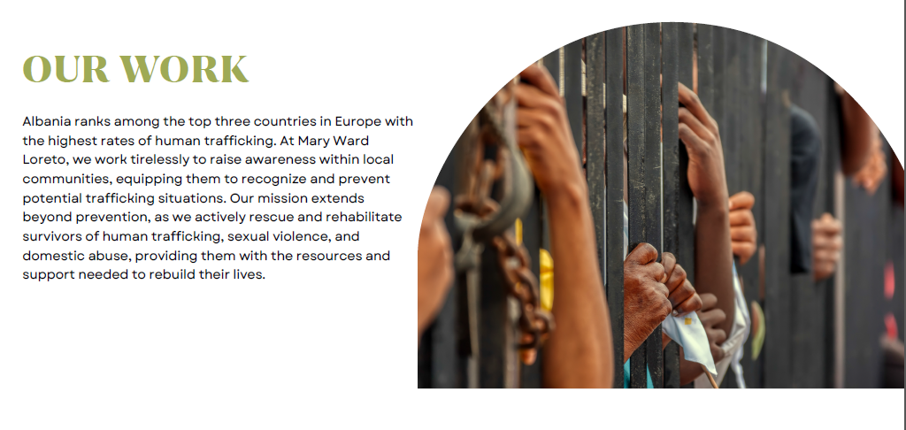
Mary Ward Loreto: Working Together to Secure Freedom from Human Trafficking in Albania and UK

Slide 3
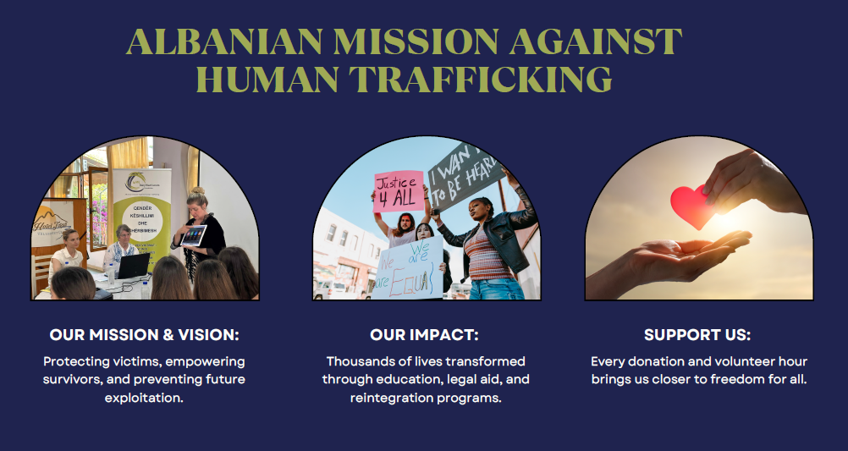
Mary Ward Loreto: Working Together to Secure Freedom from Human Trafficking in Albania and UK

Slide 4
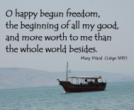


Mary Ward Loreto: Working Together to Secure Freedom from Human Trafficking in Albania and UK
“What we stand for” – a word from the CEO of MWL
Freedom – Dignity – Justice, these three words have been the motivation for our existence and for guiding our work.
Since 2012, we have stood on the front lines of the fight against Human Trafficking in Albania, helping thousands reclaim their lives and thrive.
Our core values of truth, responsibility, integrity, courage, and empathy guide our actions, fostering trust and promoting systemic change.

Slide 5
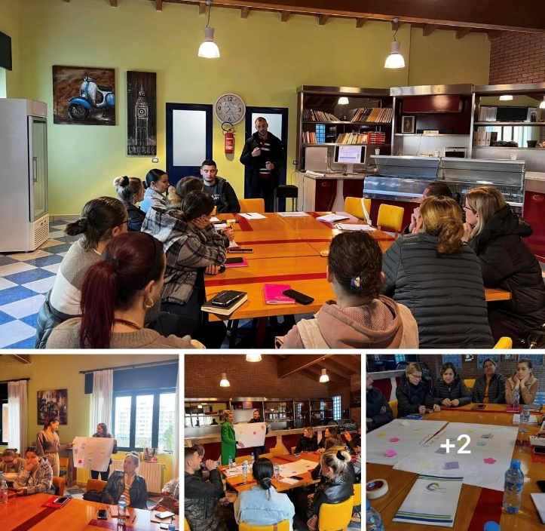
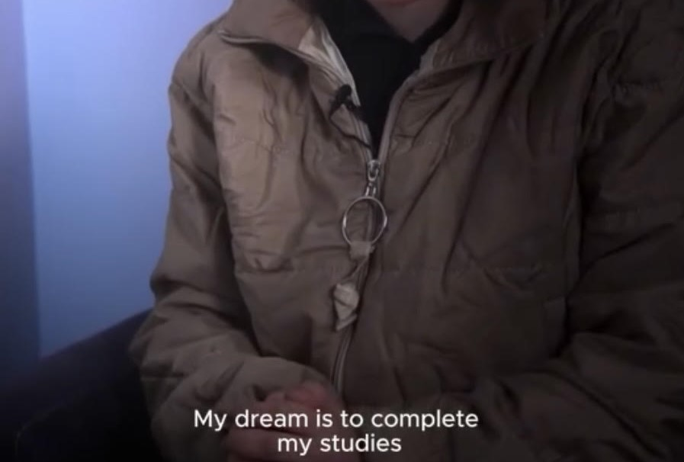
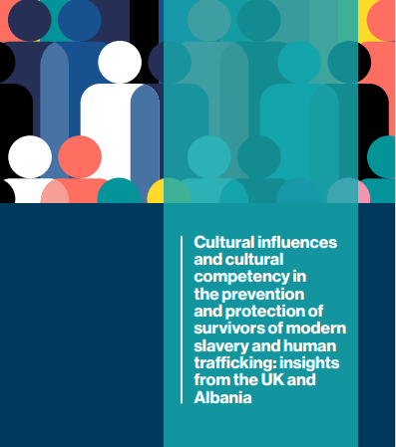

Securing Freedom from Human Trafficking in Albania
Human Trafficking: Protect Programme = 6 Advice and Service Centres, ASC – Direct response: serving victims and survivors through comprehensive life-changing services
Diversity and Social Inclusion (DSI) = EMPOWER Program - building a justice and equity driven movement centred around human rights for youth and women
Research Education Training and Advocacy (RETA) + Prevent Program – Turning knowledge into strategies for policy action to disrupt and prevent human trafficking and modern slavery
PROTECT
EMPOWER
PREVENT

Slide 6
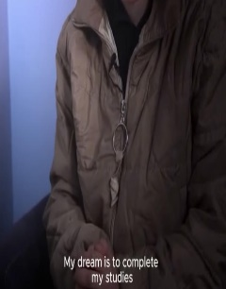

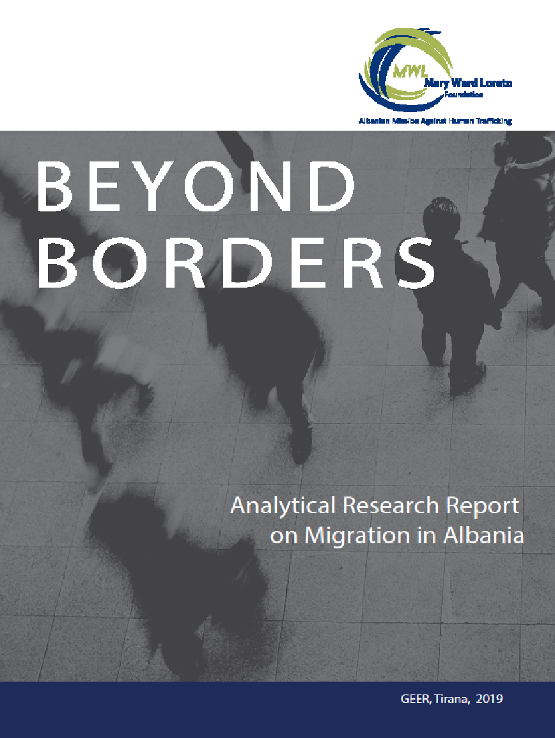
Securing Freedom from Human Trafficking in Albania
PROTECT
Emergency accommodation
Legal advice
Psych support
Medical support / aid
Social care
Referral and accompanying to services
First Steps to Recovery
EMPOWER
Women’s empowerment
Youth empowerment
Service learning
Vocational education
Employment assistance
Broad Based Organizing
PREVENT
Research and publications
Conferences
Advocacy
Community engagement
Partnerships for policy action
Capacity building
Strategic communication

Slide 7
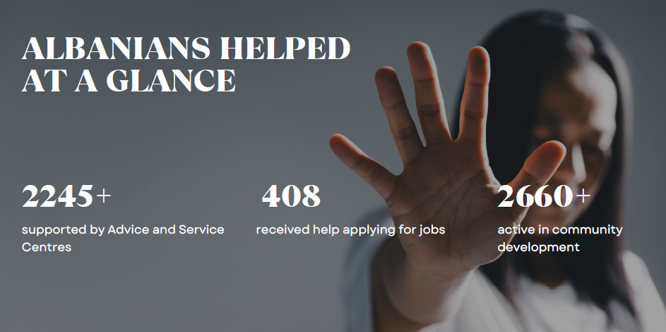
TOGETHER AGAINST HUMAN TRAFFICKING
TRUTHFULNESS: 2024
STEADFASTNESS:2024-2025:
New Challenges in MSHT Albanian Mission:
NOW: Country of Origin
And Country of Destination. Where From:
Bangladesh, India, China, Philippines, Ivory Coast, Kenya, Uganda, Central Africa, Nigeria, Cameroons
- A story

Slide 8
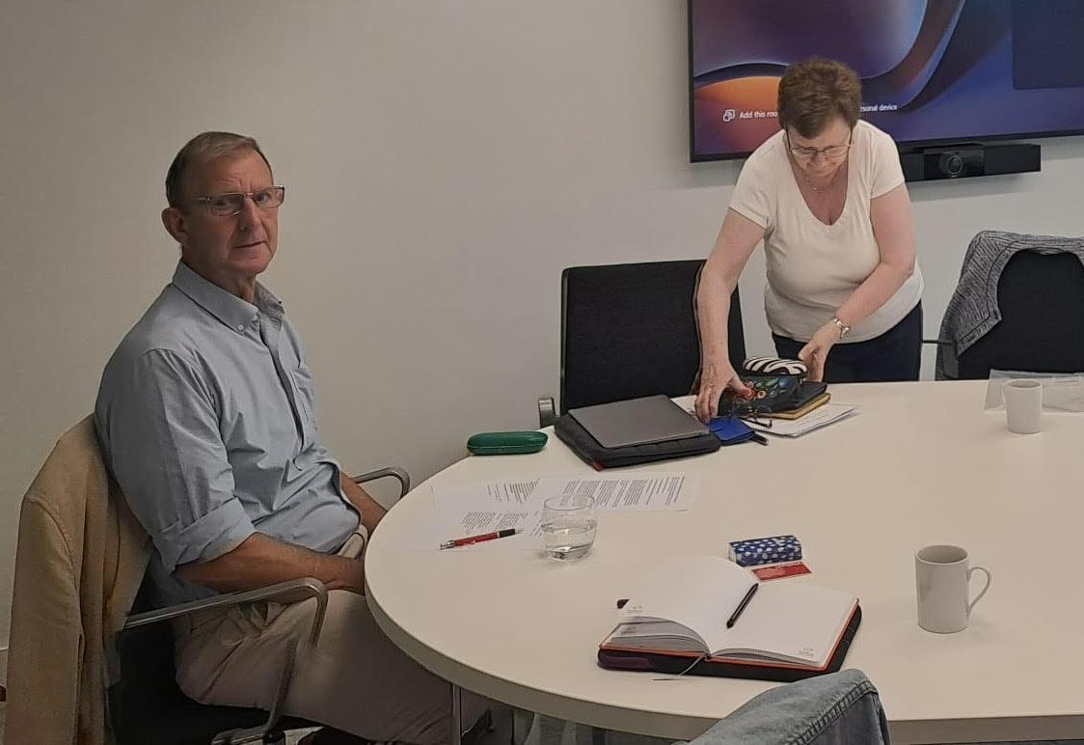
TOGETHER AGAINST HUMAN TRAFFICKING
Mary Ward Loreto UK Charity
Founded 2022 with these objectives:
- Raising awareness of the problem of Human Trafficking in Albania and in UK.
- Fund-raising to support the work of its sister charity in Albania
“Mary Ward Loreto Albania”
Registered UK Charity ( Number 1192478)
www.marywardloreto.org
11 Trustees on the Board
4 Patrons: Julie Etchingham, Kevin Hyland OBE,
Baroness Helena Kennedy,
Sir Christian Sweeting
Target for fund-raising P.A.: £300,000
Actual to date: £100,000
William Morrell: Chairperson
Dr Mary McHugh CE
Preparing for the Annual Physical Board Meeting in London 2024

Slide 9
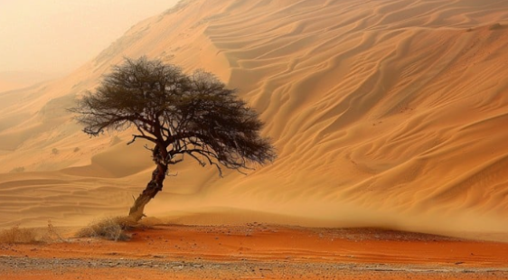
TOGETHER AGAINST HUMAN TRAFFICKING
Thank you!
Imelda Poole IBVM

